Slide 1


Federico Prado
25th January 2025

Slide 2

Outline
Executive Summary
Introduction
Methodology
Results
Conclusion
Appendix

Slide 3
Executive Summary
Applied methodologies:
In this project, a variety of methodologies were employed to conduct the analysis. The dataset was standardized and subsequently split into training and testing subsets. These subsets were utilized to determine the optimal hyperparameters for Support Vector Machines (SVM), Classification Trees, and Logistic Regression models.
Summary of all results:
The analysis resulted in the development of a predictive model. This model achieves an accuracy of 87.50% in forecasting the probability of the Falcon 9 first stage successfully landing on its next mission.

Slide 4
Introduction
SpaceX advertises Falcon 9 rocket launches on its website, with a cost of 62 million dollars; other providers cost upward of 165 million dollars each, much of the savings is because SpaceX can reuse the first stage.
This report explores whether an alternative company could compete with SpaceX by accurately predicting the success of the first stage landing. To achieve this, it is crucial to determine the likelihood of the first stage's successful recovery, which has significant implications for the overall launch costs.

Slide 5

Section 1

Slide 6
Methodology
Executive Summary
Data collection methodology:
The data was gathered from two main sources:
SpaceX API REST
External source: Wikipedia tables, downloaded using BeautifulSoup library
Perform data wrangling
Calculated and filling the missing values for each attribute
Determined the number of launches on each site and on which orbit
Created a numerical class to categorize whether the landing was successful or not
Perform exploratory data analysis (EDA) using visualization and SQL
Perform interactive visual analytics using Folium and Plotly Dash
Perform predictive analysis using classification models
Standardized the dataset and split it into training and testing subsets
Developed different classification models using hyper-parametrized values

Slide 7
Data Collection
Sources of Data
SpaceX API REST: Used to fetch real-time and historical data on Falcon 9 launches
External Source: Wikipedia tables were downloaded using the BeautifulSoup library to obtain additional data on launch sites and orbit types
Data Collection Process
API Integration: Connected to the SpaceX API REST to retrieve launch data, including details on launch dates, sites, and outcomes
Web Scraping: Utilized BeautifulSoup to scrape tables from Wikipedia, focusing on information related to launch sites and orbits
Data Cleaning: Addressed missing values by calculating and imputing them for each attribute
Data Wrangling
Standardization: Standardized the collected data to ensure uniformity and consistency
Categorization: Created a numerical class to categorize the success of the Falcon 9 first stage landings

Slide 8
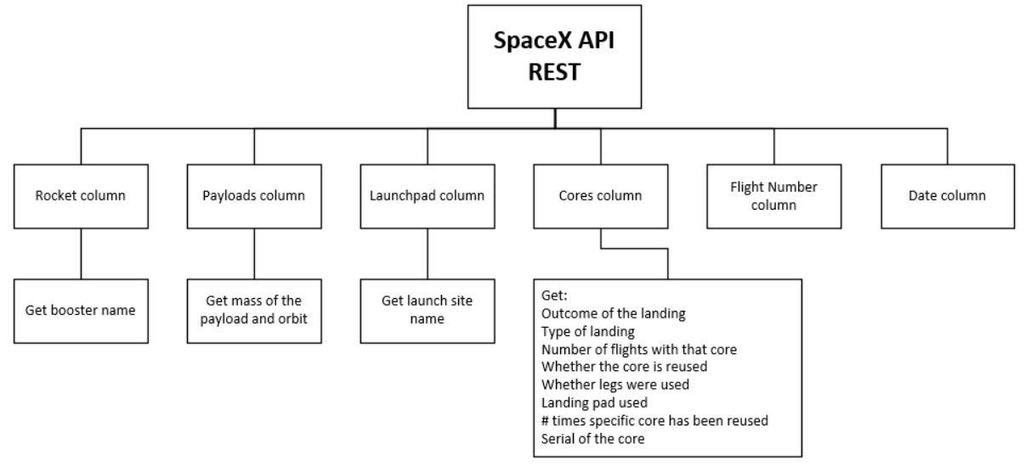
Data Collection – SpaceX API
GitHub URL of the completed SpaceX API calls notebook [SpaceX-Project/C10M01 - spacex-data-collection-api.ipynb]:
https://github.com/FPtecno/IBM-DS-FP/blob/0cf74742eb8af0127eeb8c20ea7d28a6aba6a39b/SpaceX-Project/C10M01%20-%20spacex-data-collection-api.ipynb

Slide 9
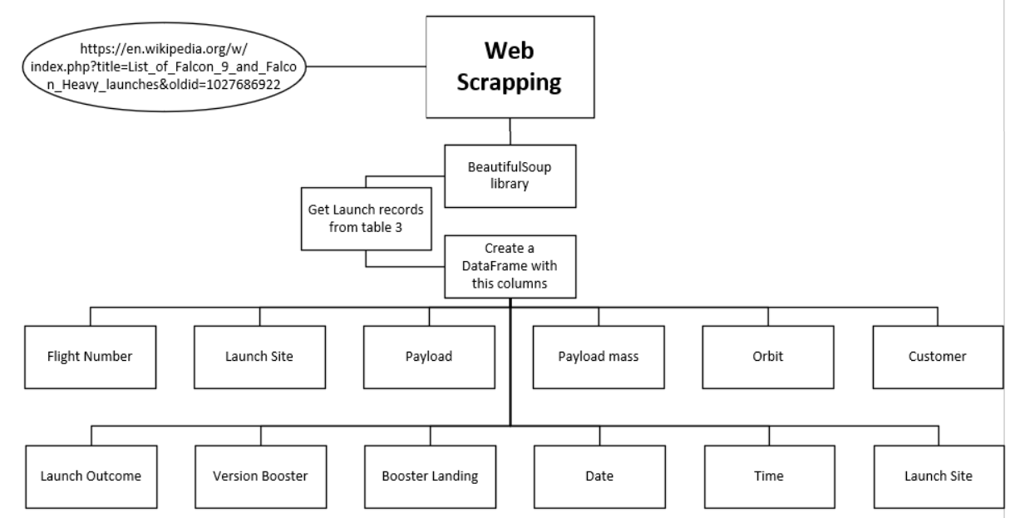
Data Collection – Scraping
GitHub URL of the completed web scraping notebook [SpaceX-Project/C10M01 - spacex-webscraping.ipynb]:
https://github.com/FPtecno/IBM-DS-FP/blob/0cf74742eb8af0127eeb8c20ea7d28a6aba6a39b/SpaceX-Project/C10M01%20-%20spacex-webscraping.ipynb

Slide 10
Data Wrangling
Key Steps done:
Identify and Calculate Missing Values: Determined the percentage of missing values in each attribute and calculated appropriate replacements
Identify Column Types: Identified the data types for each column to ensure accurate processing
Launch Site Analysis: Calculated the number of launches on each site
Orbit Analysis: Calculated the number and occurrence of each orbit
Mission Outcome Analysis: Calculated the number and occurrence of mission outcomes for each orbit
Create Landing Outcome Label: Created a landing outcome label from the outcome column called "Class" (0 for bad outcomes, 1 for successful landings)

Slide 11
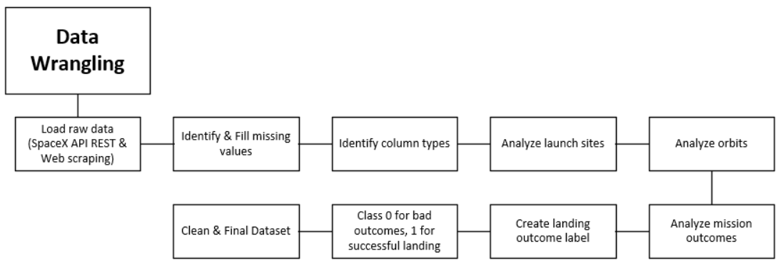
Data Wrangling
GitHub URL of the completed data wrangling related notebook [SpaceX-Project/C10M01 - spacex-Data wrangling.ipynb]:
https://github.com/FPtecno/IBM-DS-FP/blob/0cf74742eb8af0127eeb8c20ea7d28a6aba6a39b/SpaceX-Project/C10M01%20-%20spacex-Data%20wrangling.ipynb

Slide 12
EDA with Data Visualization
Catplot: Flight Number vs. Payload Mass (kg): To investigate the relationship between the flight numbers and the payloads they carried. This helps in understanding how payload capacities might have evolved over different flights.
Catplot: Flight Number vs. Launch Site: To examine the distribution of flights across various launch sites. This visualization highlights any predominant launch sites used more frequently and provides insights into launch site preferences or trends.
Scatterplot: Payload Mass (kg) vs. Launch Site: To explore the relationship between payload mass and launch sites. This helps in determining if certain launch sites handle heavier payloads more often, which can be important for planning and optimization.
Barplot: Success Rate of Each Orbit Type: To compare the success rates of different orbit types. This information is crucial for understanding which orbit types have higher success rates, providing valuable insights for strategic decision-making.

Slide 13
EDA with Data Visualization
Scatterplot: Flight Number vs. Orbit Type: To analyze how orbit types vary with flight numbers. This helps in identifying any patterns or shifts in orbit type preferences over time.
Scatterplot: Payload Mass (kg) vs. Orbit Type: To visualize the relationship between payload mass and orbit types. This aids in determining if certain orbits are associated with heavier or lighter payloads, which can influence future launch planning.
GitHub URL of the completed EDA with data visualization notebook [SpaceX-Project/C10M02 - EDA-dataviz.ipynb]:
https://github.com/FPtecno/IBM-DS-FP/blob/0cf74742eb8af0127eeb8c20ea7d28a6aba6a39b/SpaceX-Project/C10M02%20-%20EDA-dataviz.ipynb

Slide 14
EDA with SQL
Summarize of SQL queries performed:
Unique Launch Sites: Identified the names of the unique launch sites involved in space missions.
Launch Sites starting with 'CCA': Retrieved records where the launch sites begin with 'CCA’.
Total Payload Mass by NASA (CRS): Calculated the total payload mass carried by boosters launched by NASA (CRS).
Average Payload Mass for F9 v1.1: Determined the average payload mass carried by the booster version F9 v1.1.
First Ground Pad Landing Success: Listed the date when the first successful landing outcome on a ground pad was achieved.

Slide 15
EDA with SQL
Successful Drone Ship Boosters with Specific Payload: Identified the boosters that have successful landings on a drone ship and have a payload mass between 4000 and 6000 kg.
Total Successful and Failed Missions: Summarized the total number of successful and failed mission outcomes.
Booster Versions with Maximum Payload: Listed the booster versions which have carried the maximum payload mass.
Failures in Drone Ship Landings in 2015: Listed records displaying the month names, failed drone ship landings, booster versions, and launch sites for the months in the year 2015.
Landing Outcomes Ranked: Ranked landing outcomes between the dates 2010-06-04 and 2017-03-20 in descending order of occurrences.
GitHub URL of the completed EDA with SQL notebook [SpaceX-Project/C10M02 - SQL-coursera_sqllite.ipynb]:
https://github.com/FPtecno/IBM-DS-FP/blob/0cf74742eb8af0127eeb8c20ea7d28a6aba6a39b/SpaceX-Project/C10M02%20-%20SQL-coursera_sqllite.ipynb

Slide 16
Build an Interactive Map with Folium
Summarize of markers, circles, lines that I’ve created and added to the folium map:
Circles and Markers for Each Launch Site (CCAFS LC-40, CCAFS SLC-40, KSC LC-39A, VAFB SLC-4E).
Purpose: To visually identify and highlight the locations of different launch sites on the map. This provides a clear and easy reference for the geographic distribution of the launch sites.
Markers Inside Marker Cluster for Launch Outcomes (Success or failure).
Purpose: To succinctly represent the outcomes of launches at each site. The clustering helps manage map clutter and allows for better visualization when multiple launches have occurred at the same location.
Mouse Position.
Purpose: To estimate the position on the map. This feature is added to easily find the coordinates of any points of interest. It aids in quickly pinpointing specific locations without manual coordinate lookup.

Slide 17
Build an Interactive Map with Folium
Markers for Nearby Coastline, Railways, Highways, and Cities.
Purpose: To indicate and highlight crucial surrounding infrastructure. This provides context about the proximity of important infrastructure elements, which are critical considerations for launch operations and logistics.
Polyline Indicating the Distance Between Points.
Purpose: This line connects chosen points with the selected launch center, illustrating the distance between them. This can be useful for measuring and visualizing spatial relationships and distances pertinent to logistics planning.
GitHub URL of the completed Interactive Map with Folium map, notebook [SpaceX-Project/C10M03 - launch-site-location.ipynb]:
https://github.com/FPtecno/IBM-DS-FP/blob/0cf74742eb8af0127eeb8c20ea7d28a6aba6a39b/SpaceX-Project/C10M03%20-%20launch-site-location.ipynb

Slide 18
Build a Dashboard with Plotly Dash
Here's a summary of the plots/graphs and interactions that I’ve added to my dashboard:
Plots/Graphs Added:
Dropdown List for Launch Site Selection: To enable users to select and filter data by specific launch sites. This interaction allows for focused analysis and visualization of data pertaining to the chosen site.
Pie Chart Showing Total Successful Launches Count for Launch Sites: To visually represent the distribution of successful launches across different launch sites.
Slicer to Select Payload Mass (kg) Range: To allow users to filter and analyze data based on specific payload mass ranges. This interaction helps in examining how payload mass impacts various factors, such as launch success rates, by focusing on different payload categories.

Slide 19
Build a Dashboard with Plotly Dash
Scatter Chart Showing Correlation Between Payload Mass (kg) and Launch Success: To visualize the relationship between payload mass and the success of launches. The scatter chart helps in identifying any trends or correlations, providing insights into how payload weight might influence the likelihood of a successful launch.
Interactions Added:
Dropdown List for Launch Site Selection: Enhances user interactivity by allowing the selection of specific launch sites, thereby filtering the visualized data dynamically.
Payload Mass (kg) Range Slicer: Offers a flexible and interactive way for users to filter data based on payload mass, making it easier to focus on specific weight categories and analyze related trends.
GitHub URL of the completed Dashboard with Plotly Dash, python [SpaceX-Project/C10M03 - spacex_dash_app.py]:
https://github.com/FPtecno/IBM-DS-FP/blob/0cf74742eb8af0127eeb8c20ea7d28a6aba6a39b/SpaceX-Project/C10M03%20-%20spacex_dash_app.py

Slide 20
Predictive Analysis (Classification)
Model Development Process:
Data Preparation:
Created a column to classify landings as successful or failure.
Standardized the dataset using StandardScaler for consistent scales.
Data Splitting:
Split the dataset into training and testing sets using train_test_split to ensure the model can be evaluated properly.
Model Building and Hyperparameter Tuning:
Created GridSearchCV objects for various classifiers to find the best parameters:
Logistic Regression: Achieved an accuracy of 84.64%.
Support Vector Machine: Achieved an accuracy of 84.82%.
Decision Tree Classifier: Achieved an accuracy of 87.50%.
K-Nearest Neighbors: Achieved an accuracy of 84.82%.
Model Evaluation:
Plotted confusion matrices for each classifier to evaluate their performance and identify the best option.

Slide 21
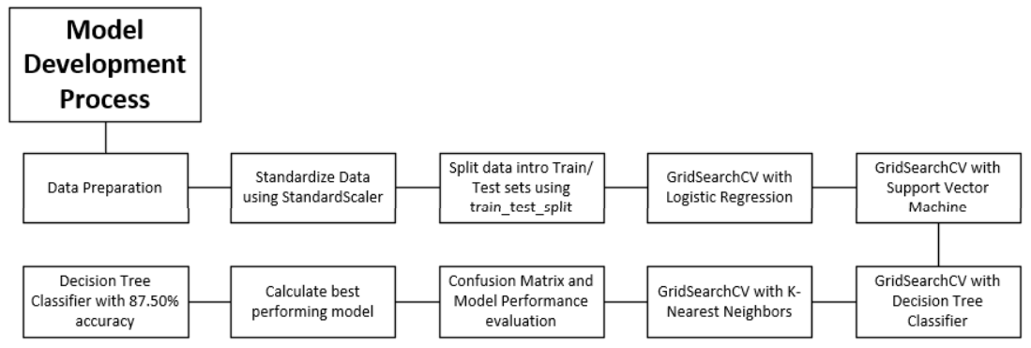
Predictive Analysis (Classification)
GitHub URL of the completed predictive analysis lab, notebook [SpaceX-Project/C10M04 - SpaceX-Machine-Learning-Prediction-Part-5.ipynb]:
https://github.com/FPtecno/IBM-DS-FP/blob/0cf74742eb8af0127eeb8c20ea7d28a6aba6a39b/SpaceX-Project/C10M04%20-%20SpaceX-Machine-Learning-Prediction-Part-5.ipynb

Slide 22
Results
Exploratory Data Analysis (EDA) Results
Flight Number vs. First Stage Landing: As the flight number increases, the first stage is more likely to land successfully.
Payload Mass: Heavier payloads reduce the likelihood of the first stage returning successfully. No rockets were launched from VAFB-SLC for payloads greater than 10,000 kg.
Orbit Type Success Rates: For LEO, success appears correlated with the number of flights. For GTO, no clear flight number relationship exists. Polar, LEO, and ISS orbits have higher success rates for heavy payloads, unlike GTO, which shows mixed results.
Success Rate Over Time: Since 2013, success rates increased till 2017, with stability in 2014 and a marked increase post-2015.
Data Insights:
Total payload mass carried by NASA (CRS) boosters: 619,967 kg.
Average payload mass for F9 v1.1: 2,928.4 kg.
First successful ground pad landing: 2015-12-22.

Slide 23
Results
Interactive Analytics Demo in Screenshots
Dropdown List: Allows launch site selection for focused data visualization.
Pie Chart: Displays the count of successful launches per launch site.
Slicer: Filters data by payload mass range for specific weight category analysis.
Scatter Chart: Shows the correlation between payload mass and launch success.
Predictive Analysis Results
Logistic Regression: Achieved an accuracy of 84.64%.
Support Vector Machine: Achieved an accuracy of 84.82%.
Decision Tree Classifier: Achieved an accuracy of 87.50%.
K-Nearest Neighbors: Achieved an accuracy of 84.82%.
Conclusion: The Decision Tree Classifier was identified as the best-performing model, with the highest accuracy.

Slide 24

Section 2

Slide 25
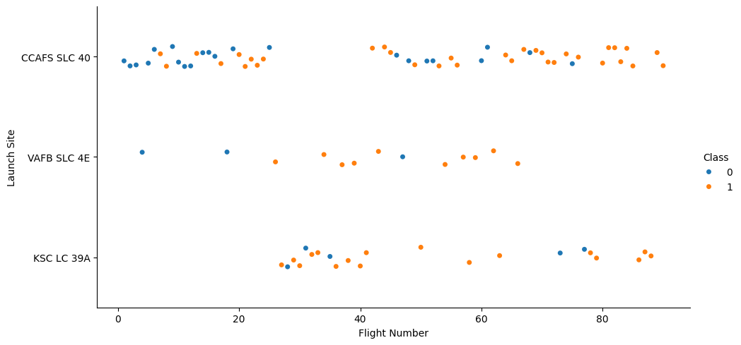
Flight Number vs. Launch Site
As the frequency of flights increases, there is a corresponding rise in the probability of a successful landing, with the VAFB SLC-4E launch site demonstrating the highest success rate among all sites.

Slide 26
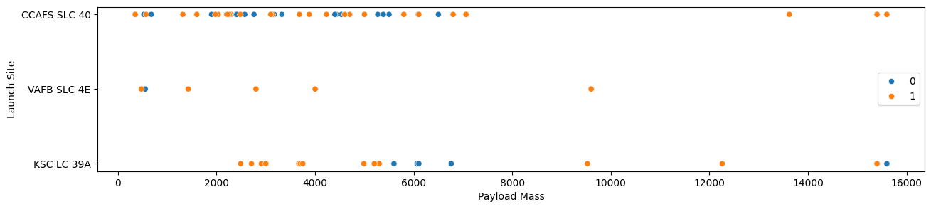
Payload vs. Launch Site
At the VAFB-SLC launch site, no rockets have been launched with payloads exceeding 10,000 kg.

Slide 27
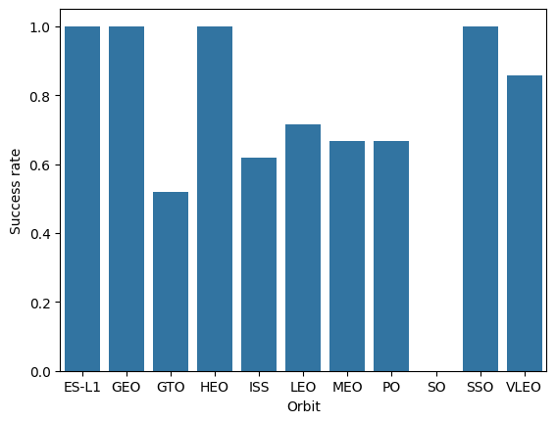
Success Rate vs. Orbit Type
Orbits such as ES-L1, GEO, HEO, and SSO demonstrate near-perfect success rates (~1.0), while orbits like LEO, MEO, and PO exhibit moderate success rates ranging from approximately 0.65 to 0.75. In contrast, the SO (Solar Orbit) type shows a notably low success rate (~0.0).

Slide 28
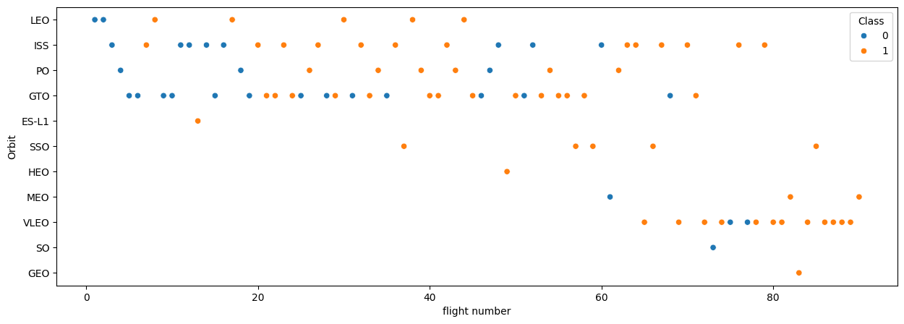
Flight Number vs. Orbit Type
For LEO orbits, the success rate appears to be related to the number of flights; however, in GTO orbits, no relationship is observed between flight number and success rate.

Slide 29
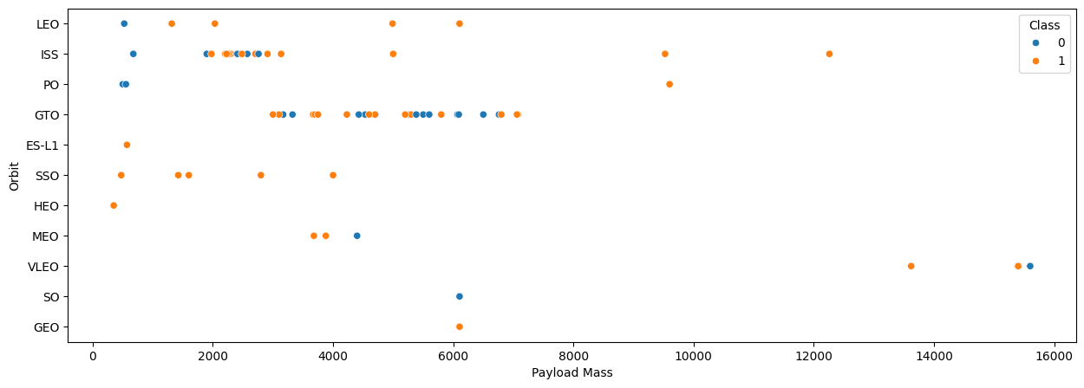
Payload vs. Orbit Type
For heavy payloads, the successful landing rates are higher for Polar, LEO, and ISS orbits. However, for GTO orbits, it is difficult to distinguish between positive and negative landing outcomes, as both successful and unsuccessful missions are equally represented.

Slide 30
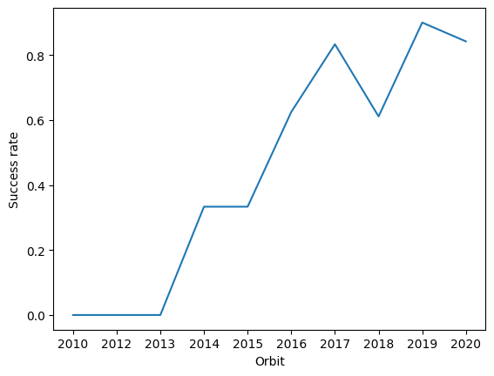
Launch Success Yearly Trend
The success rate has been increasing since 2013, with stability observed in 2014, and a marked rise post-2015, continuing through 2017.

Slide 31
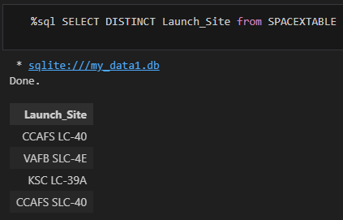
All Launch Site Names
Unique launch sites:
CCAFS LC-40
VAFB SLC-4E
KSC LC-39A
CCAFS SLC-40

Slide 32
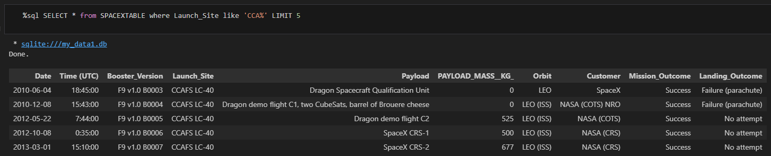
Launch Site Names Begin with 'CCA'
There are 2 options: CCAFS LC-40 or SLC-40

Slide 33
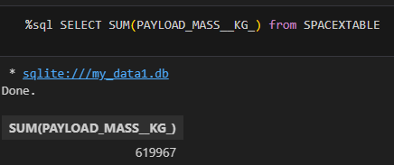
Total Payload Mass
Total payload mass carried by NASA (CRS) boosters: 619,967 kg.

Slide 34
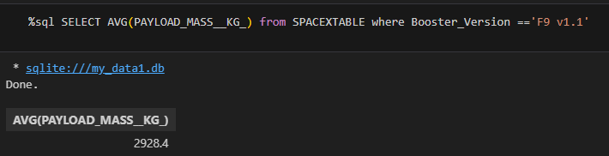
Average Payload Mass by F9 v1.1
Average payload mass for F9 v1.1: 2,928.4 kg.

Slide 35
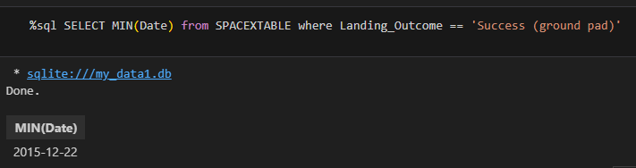
First Successful Ground Landing Date
First successful ground pad landing: 2015-12-22.

Slide 36
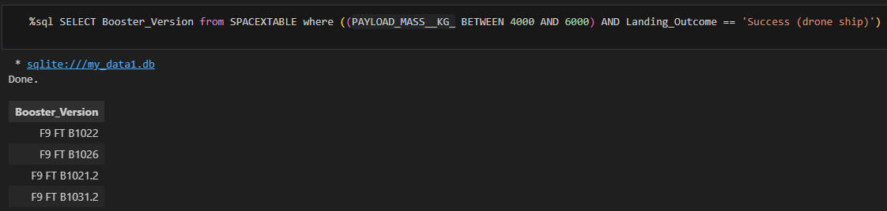
Successful Drone Ship Landing with Payload between 4000 and 6000
Names of boosters which have successfully landed on drone ship and had payload mass greater than 4000 but less than 6000:
F9 FT B1022
F9 FT B1026
F9 FT B1021.2
F9 FT B1031.2

Slide 37
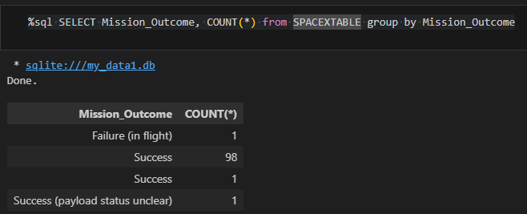
Total Number of Successful and Failure Mission Outcomes
Successful outcomes: 100
Failure outcome: 1 (in flight)

Slide 38
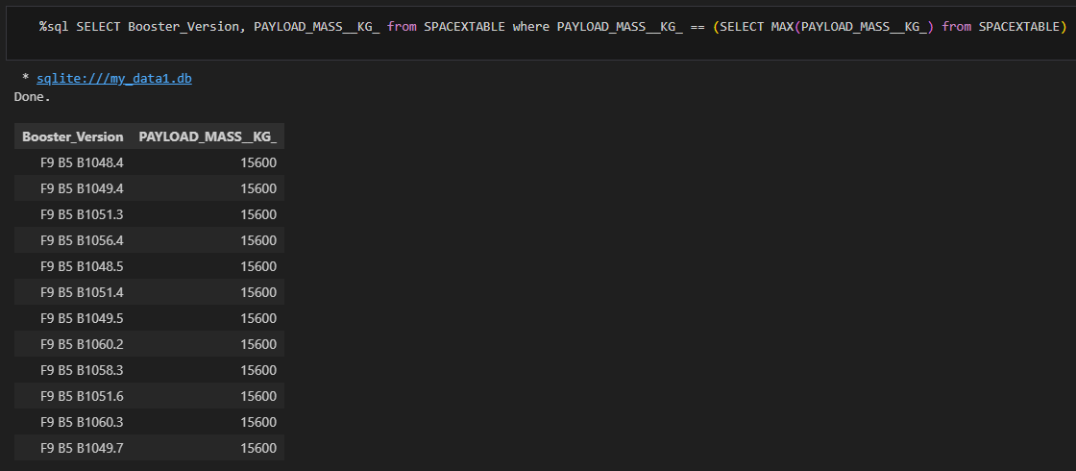
Boosters Carried Maximum Payload

Slide 39
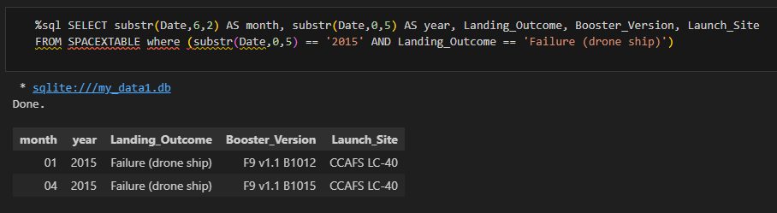
2015 Launch Records
There were 2 failed landing outcomes in drone ship: one in January and the other on April. Both of them on CCAFS LC-40 launch site.

Slide 40
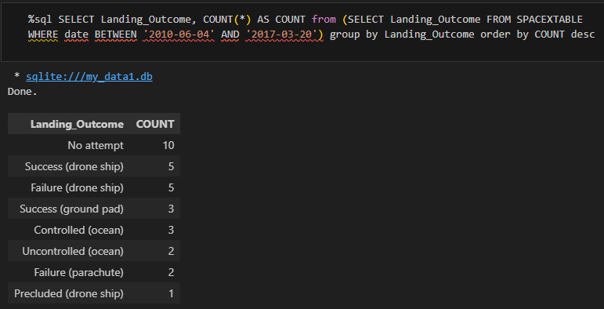
Rank Landing Outcomes Between 2010-06-04 and 2017-03-20
The table summarizes various landing outcomes with notable observations. The highest count is seen in instances where no landing attempt was made (10). Drone ship landings show an equal distribution of successes and failures, each with 5 instances. There are 3 successful landings on the ground pad, and ocean landings are split between controlled (3 instances) and uncontrolled (2 instances). Parachute failures are noted twice, while there is 1 instance where an attempted landing on the drone ship was precluded. These insights highlight the diversity of landing outcomes, which have significant implications for success rates and cost-efficiency in space missions.

Slide 41

Section 3

Slide 42
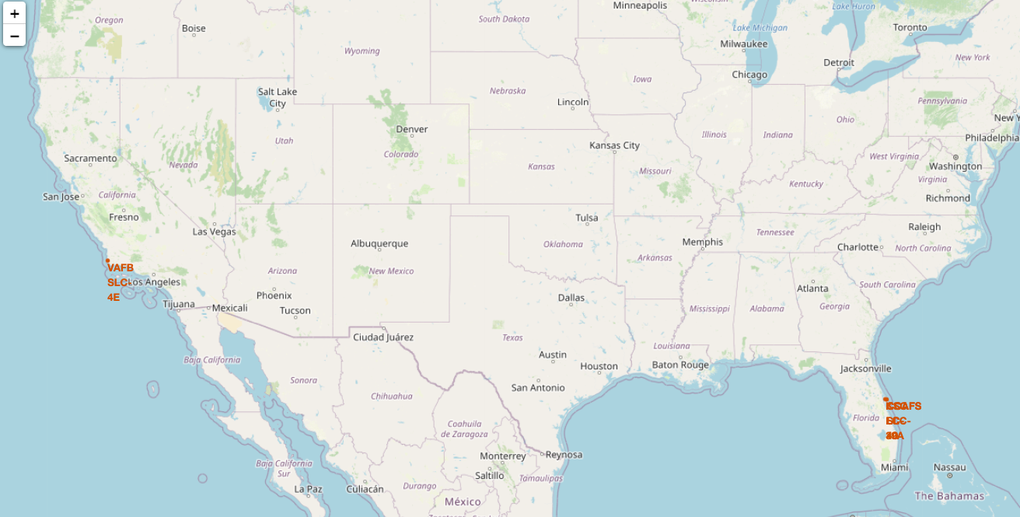
Launch sites locations

Slide 43
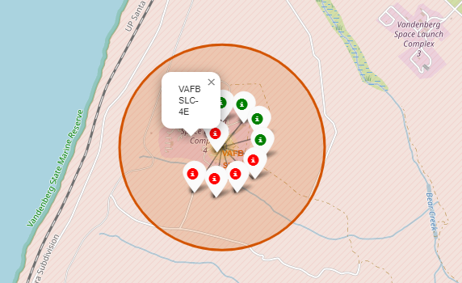
Launch outcomes classified by success or failure

Slide 44
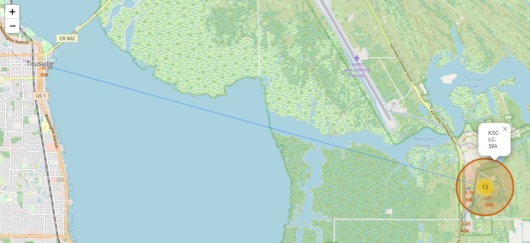
Distances to its proximities

Slide 45

Section 4

Slide 46
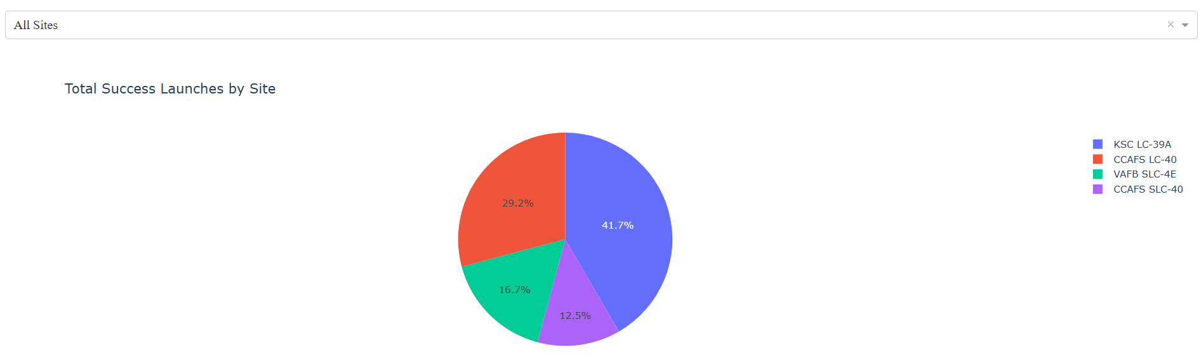
Launches Success rate by Site
The segments show that KSC LC-39A accounts for 41.7%, CCAFS LC-40 for 29.2%, VAFB SLC-4E for 16.7%, and CCAFS SLC-40 for 12.5% of the total successful launches. This chart highlights that KSC LC-39A is the most successful launch site.

Slide 47
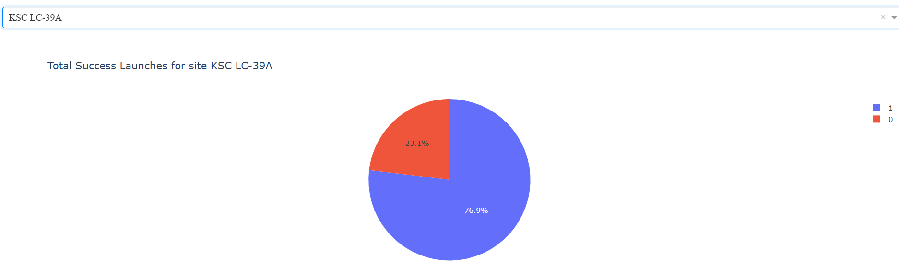
Launch Success ratio for KSC LC-39A
The segments indicate that 76.90% of the launches are successful, with the remaining 23.10% resulting in failures.

Slide 48
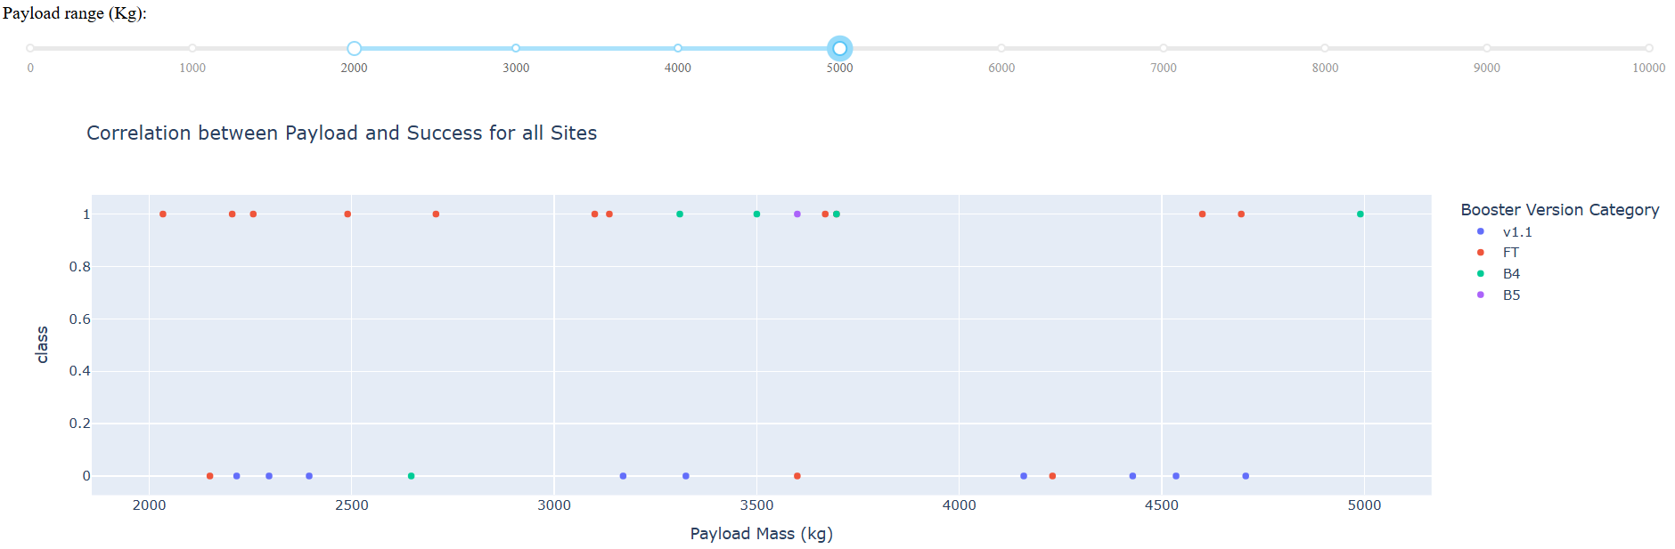
Payload Mass (kg) vs Launch Outcome
The success rate varies with different booster versions. The v1.1 (red) version is mostly successful with lighter payloads. The FT (blue) version shows consistent performance, handling a broad range of payload weights with relatively high success rates. The newer B4 (green) and B5 (purple) versions demonstrate improved success rates, even with heavier payloads.

Slide 49

Section 5

Slide 50
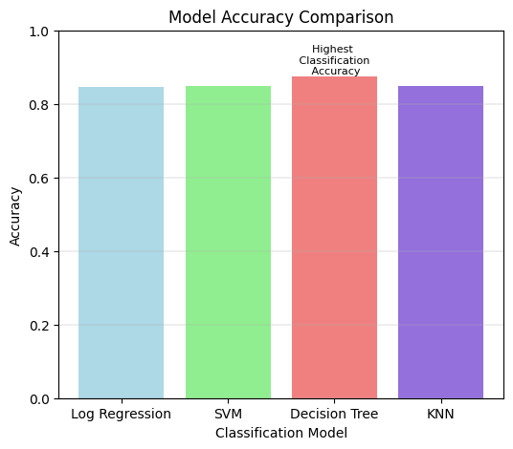
Classification Accuracy

Slide 51
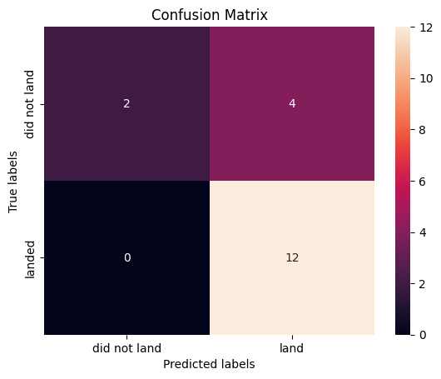
Confusion Matrix
The model has a higher success rate in predicting landings, with 12 correct predictions, compared to non-landings, with 2 correct predictions. However, the significant number of false positives (4) indicates that the model struggles with distinguishing between "did not land" and "land," often predicting "land" when it should not. The absence of false negatives highlights the model's proficiency in correctly identifying actual landings without missing any. Overall, while the model excels in predicting successful landings with high accuracy, it requires improvement in minimizing false positive predictions to enhance overall reliability.

Slide 52
Conclusions
Flight Frequency and Success: As the number of flights increases, the probability of a successful landing also rises, with the VAFB SLC-4E launch site demonstrating the highest success rate.
Payload Mass Influence: Heavier payloads decrease the likelihood of successful first-stage landings. Notably, no rockets were launched from VAFB-SLC with payloads exceeding 10,000 kg.
Orbital Success Rates:
LEO: Success appears to be related to the number of flights.
GTO: No observed relationship between flight number and success rate.
Heavy Payloads: Higher success rates for Polar, LEO, and ISS orbits, while GTO exhibits both successful and unsuccessful missions.

Slide 53
Conclusions
Success Rate Over Time: The success rate increased steadily since 2013, experienced stability in 2014, and saw a marked rise post-2015, continuing through 2017.
Logistic Regression, Support Vector Machine, and K-Nearest Neighbors: Achieved accuracies of 84.64%, 84.82%, and 84.82% respectively.
Decision Tree Classifier: Proven to be the best-performing model with an accuracy of 87.50%.
Predictive Model Development: The analysis resulted in the development of a predictive model. This model achieves an accuracy of 87.50% in forecasting the probability of the Falcon 9 first stage successfully landing on its next mission.

Slide 54
Appendix
Python Code Snippets
Data Preprocessing: Included code snippets for cleaning and preparing the data.
File: 'C10M02 - EDA-dataviz.ipynb'
Model Building: Code snippets for building and evaluating models such as decision trees and logistic regression.
File: 'C10M04 - Spacex-Machine-Learning-Prediction-Part-5.ipynb'
Visualization: Code for creating visualizations like scatter plots and bar charts.
File: 'C10M05 - Final Report.pptx'
SQL Queries
SQL queries used to extract and manipulate data from the database.
File: 'C10M02 - SQL-coursera_sqllite.ipynb'

Slide 55
Appendix
Charts and Visualizations
Examples of visualizations created, including EDA plots, confusion matrices, and performance graphs.
File: 'C10M02 - EDA-dataviz.ipynb'
Jupyter Notebook Outputs
Key analyses and outputs from Jupyter Notebooks.
File: 'C10M01 - spacex-Data wrangling.ipynb'
File: 'C10M01 - spacex-data-collection-api.ipynb'
File: 'C10M01 - spacex-webscraping.ipynb'
File: 'C10M02 - launch-site-location.ipynb'

Slide 56


